Slide 1
Oso Landslide
By Group 5:
Chris Garcia, Daniel Schwicht, & Jashod Roy
Brigham Young University, CE En 544

Slide 2
Background
Occurred in March 2014
Killed 43
$12 million cited as a conservative estimate
Residents informed… not very well

Slide 3
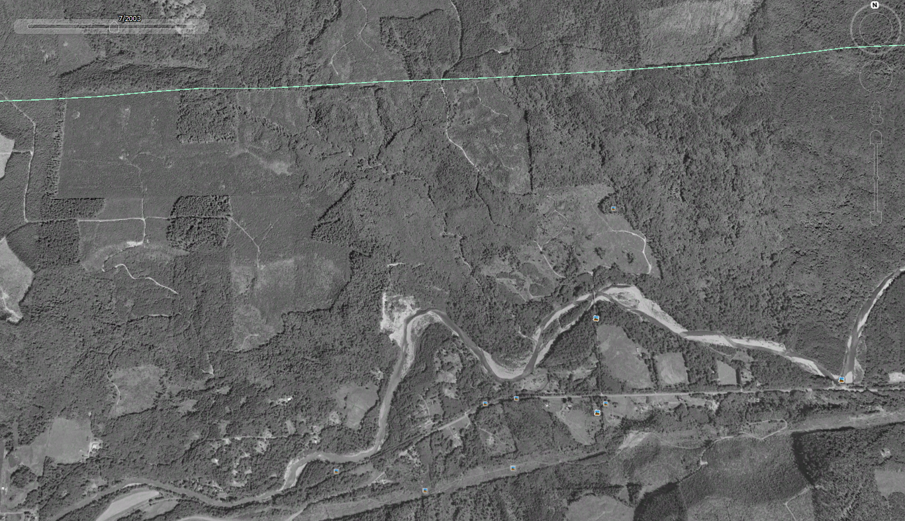
July
2003
Notes:
CHRIS: Added this and the next six slides to demonstrate how the landslide probably occurred. Images obtained from Google Earth.

Slide 4
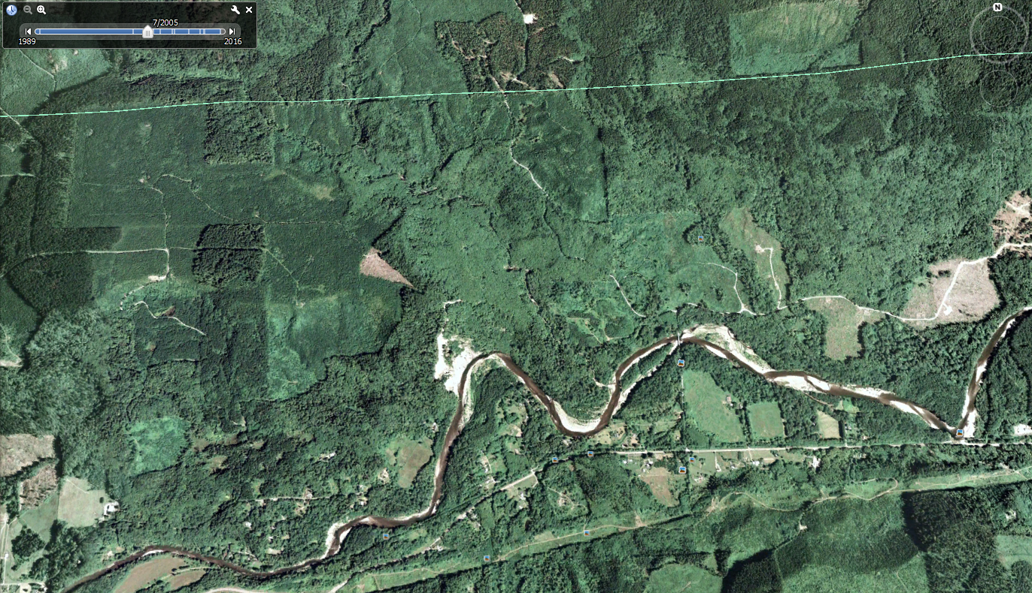
July
2005
Notes:
Here is an area of deforestation.

Slide 5
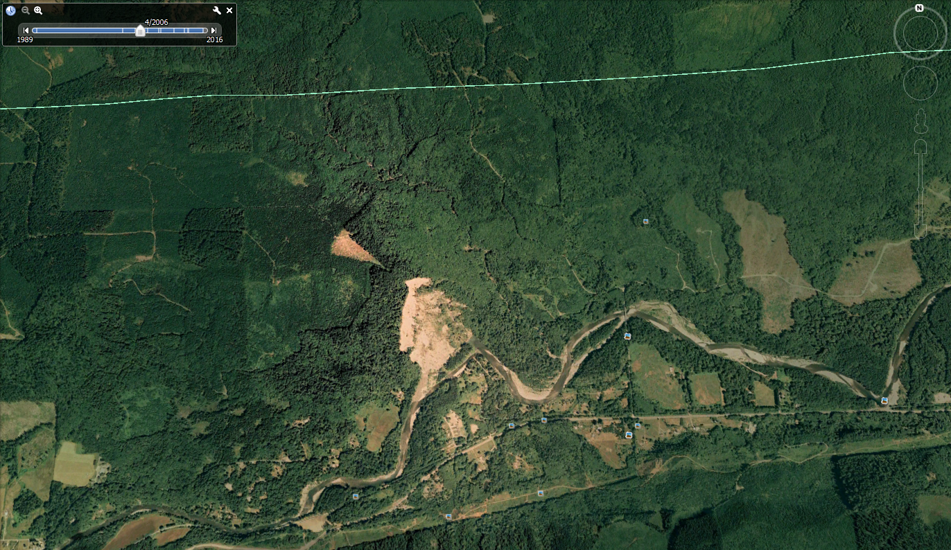
April
2006
Notes:
In early 2006, there was a landslide which partially blocked the Stillaguamish River.

Slide 6
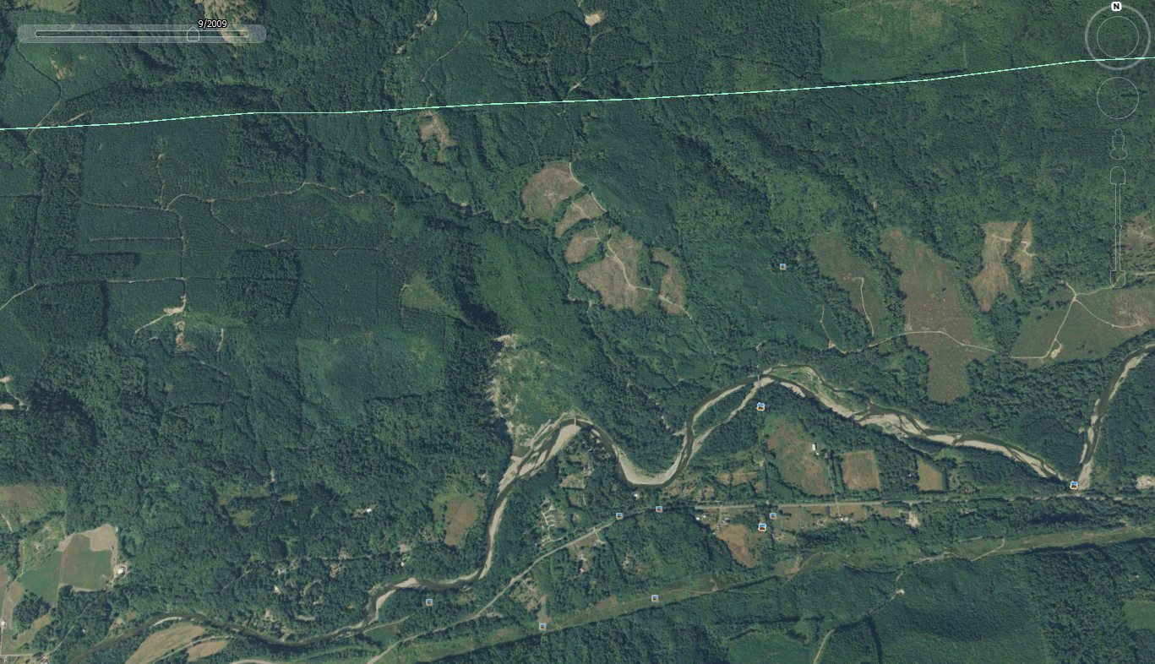
September
2009
Notes:
More deforestation occurred in 2009 in this region.

Slide 7
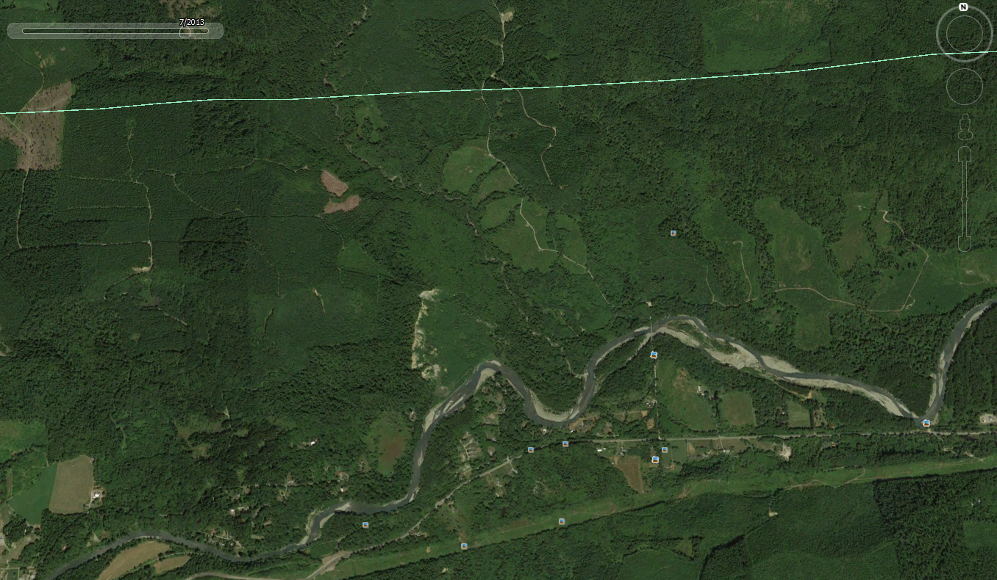
July
2013
Notes:
More deforestation occurred here in 2013.

Slide 8
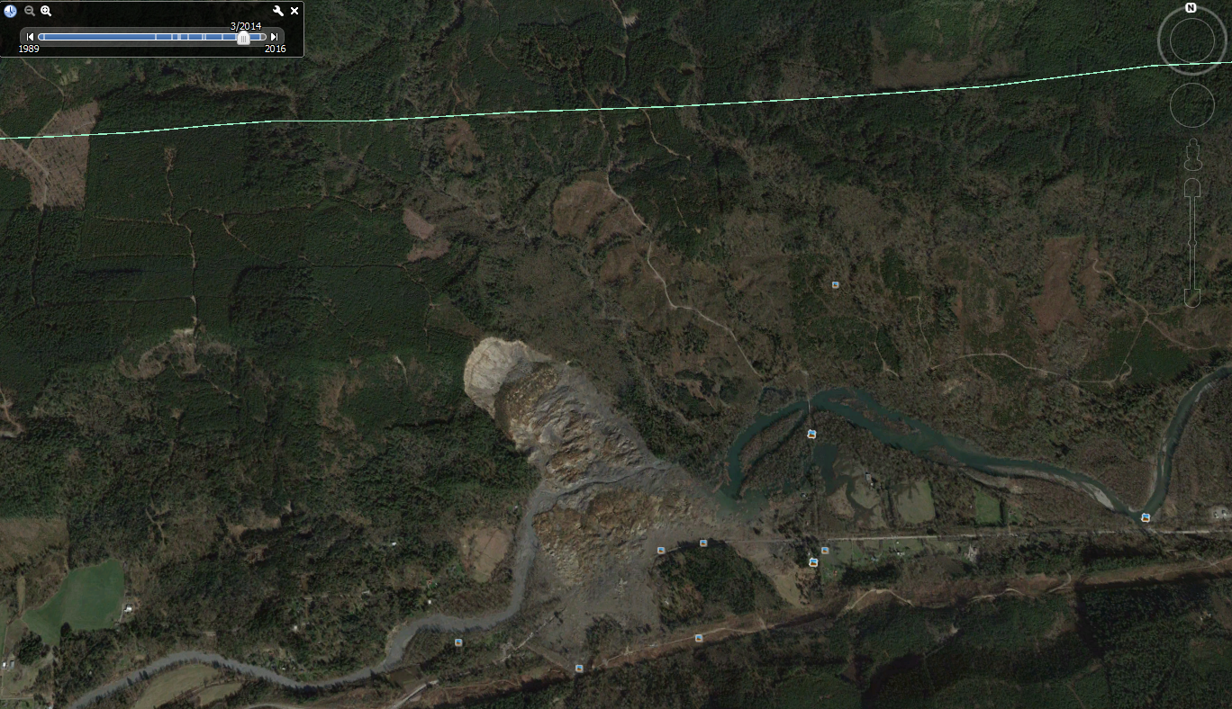
March
2014
Notes:
In March 2014, a massive landslide occurred.

Slide 9
Notes:
This slide combines the previous slides’ circles into one to illustrate the potential and progressive effects of deforestation and subsidence.

Slide 10
Notes:
DANIEL:
Here’s a 1 min video from WSJ about the slide.

Slide 11
Notes:
Here is the slide discussed in class about two months ago, showing a rotational landslide.

Slide 12
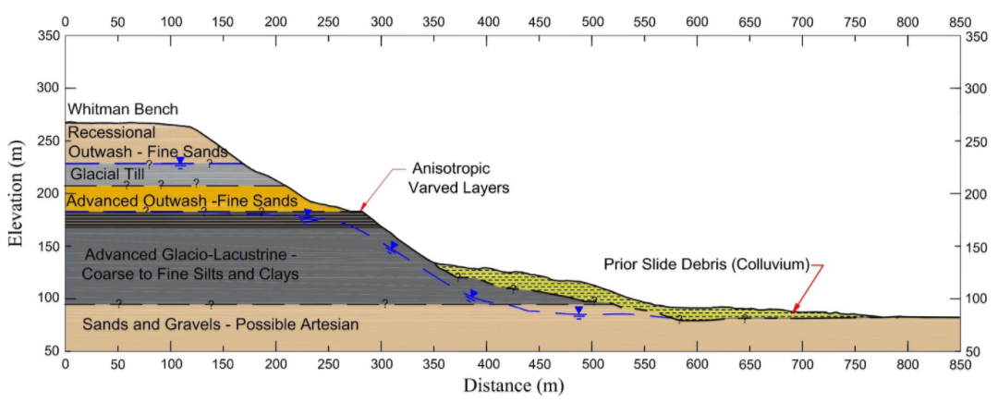
Slope Profile
Notes:
This is the slope profile from Stark’s case study. For our project, we compared Stark’s results to our own from UTEXAS. They used finite element program slopeW to find their results.
Case Study: Oso, Washington, Landslide of March 22, 2014—Material Properties and Failure Mechanism Timothy D. Stark, Ahmed K. Baghdady, Oldrich Hungr, Jordan Aaron

Slide 13
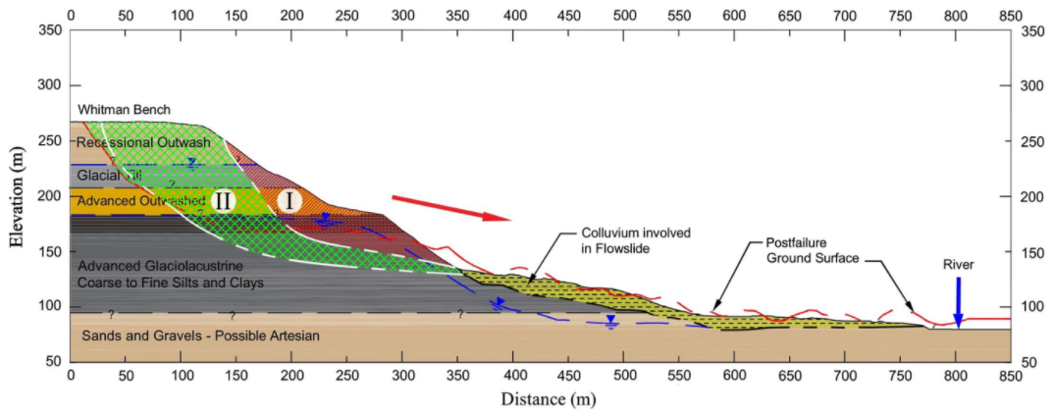
Hypothesized Failure Surfaces
Notes:
They assumed that the slide occurred in two phases (about two minutes apart, recorded by nearby seismic equipment). Here are the two failure surfaces. The loose colluvium shown below on the slope was liquefied by the initial landslide and added to the mass and momentum, making the slide more deadly, traveling 1.2 km.

Slide 14
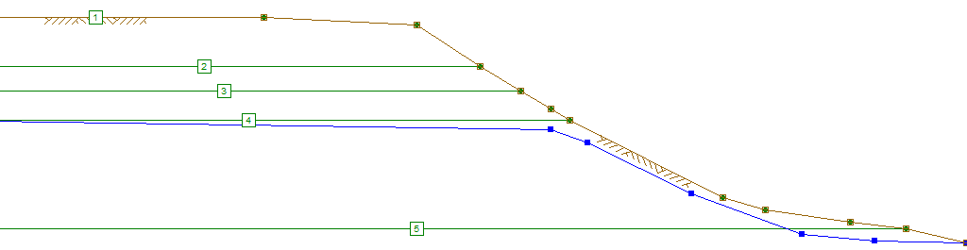
Notes:
In UTEXAS, we initially assumed a circular failure. The slope had to be smoothed out in order to avoid tiny local failures.

Slide 15
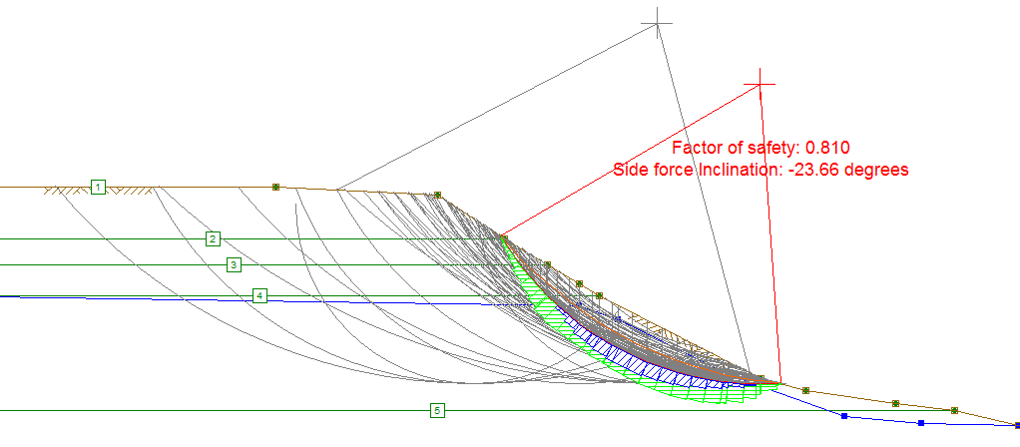
Phase I
Notes:
JASHOD:
Using a circular failure surface, an initial failure surface was calculated which was somewhat close to that calculated by Stark.

Slide 16
Failure Comparison

Slide 17
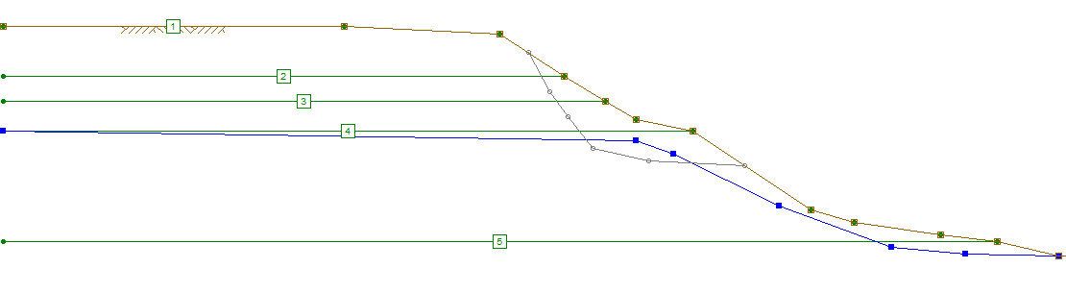
Notes:
Using a non-circular fairlure surface, here is an initial guess at a fairlure surface.

Slide 18
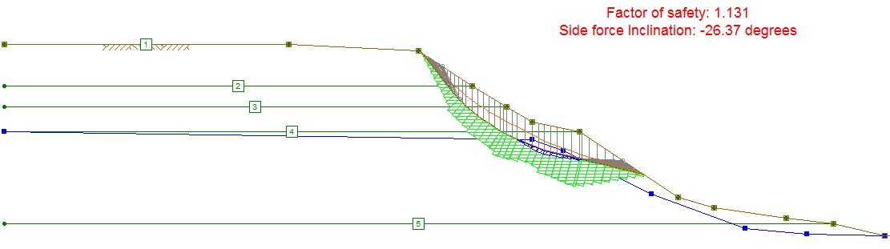

Slide 19
Failure Comparison
Notes:
As you can see, the line does have good agreement with Stark’s.

Slide 20
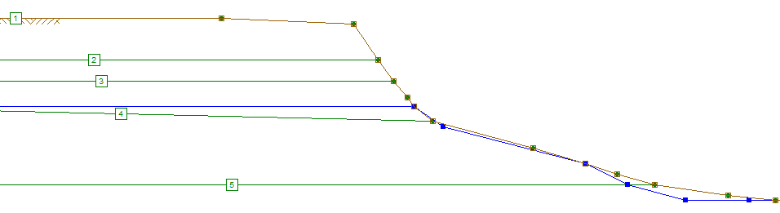
Phase II
Notes:
After initial failure, the slope looked something like this.

Slide 21
Notes:
Here is our guess for a non-circular failure surface.

Slide 22
Notes:
Here is what UTEXAS found.

Slide 23
Failure Comparison
Notes:
As you can see, the line does have decent agreement with Stark’s. While it isn’t perfect, compare that to the failure predicted using a circular surface.

Slide 24
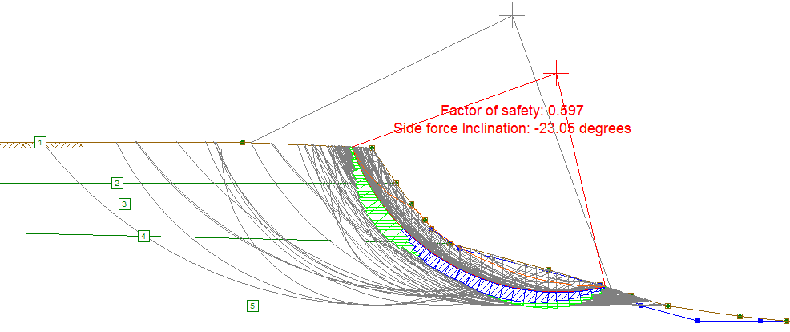
Phase II (circular)
Notes:
As you can see, the line is totally different.

Slide 25
Conclusion
UTEXAS analysis supports Stark’s conclusions
Circular failure NOT appropriate for anisotropic profile
Slope failure expected without influence of deforestation
Notes:
DANIEL:
In our case study, we confirmed with UTEXAS what Stark found using SlopeW.
We also saw an excellent example of how anisotropic profiles are the wrong situation to use circular failure surfaces.
Finally, because of our findings, we believe that the slope failure would most likely have occurred with or without deforestation.

